Slide 1
SUPPLY CHAIN
ANALYTICS
Identifying Delay Drivers & Optimizing Logistics Performance
Across India-Centric Global Trade Routes
Data: 728 Shipments • Jan 2024 – Dec 2025 • $101.8M Trade Volume
Team Members:
Simran
Janani
Manav
Anish
Rushabh
Shubham

Slide 2
Problem Statement
The Core Challenge
15.9%
Global supply chains are under growing pressure from regulatory complexity, route volatility, and unpredictable customs processing timelines. Without structured analytics, logistics teams are flying blind — reacting to delays rather than preventing them. This project answers a critical business question:
Which shipments are most likely to be delayed, and why?
of all shipments arrive delayed, impacting SLA commitments and client trust
No Visibility
Teams lack a structured view of which routes, categories, or origins drive delay risk
Reactive Model
Current operations respond to delays after they occur — no predictive capability exists
2 / 15

Slide 3
Project Objectives
01
Identify Delay Drivers
02
Quantify Risk by Segment
Determine which product categories, trade routes, origin countries, and customs timelines are most strongly correlated with shipment delays.
Calculate conditional delay probabilities across all operational dimensions to enable data-driven prioritisation for logistics teams.
03
Build a Predictive Model
04
Generate Actionable Insights
Train a machine learning model to predict delay probability for any new shipment before dispatch, enabling proactive intervention.
Translate analytical findings into specific, prioritised operational recommendations with measurable expected business impact.
3 / 15

Slide 4
Solution Overview
End-to-end analytics pipeline from raw shipment data to AI-powered recommendations
01
Data Ingestion
& Audit
02
Cleaning &
Engineering
03
Exploratory
Analysis
04
Predictive
Modelling
05
GenAI
Recommendations
Root Cause
Identification
Delay Risk
Scoring
SQL-Powered
Reporting
GenAI
Playbook
Pinpoint exact routes, categories & customs windows driving delays
Probability score for any shipment before it ships
Query-ready data model for ongoing operational reporting
AI-generated, route-specific recommendations for logistics teams
4 / 15

Slide 5
Technology Stack
Data Layer
Analytics
Visualisation
Python 3.x
Pandas
NumPy
Scikit-learn
Logistic Regression
Decision Tree
Matplotlib
Seaborn
Plotly
Data Storage
AI Integration
Collaboration
SQLite (in-memory)
CSV pipeline
Claude API (Anthropic)
Prompt engineering
Google Colab
GitHub
Google Drive
5 / 15

Slide 6
Project Workflow & System Architecture
Phase 1
Phase 2
Phase 3
Phase 4
Business
Questions
Data Cleaning
& Audit
Feature
Engineering
EDA
Anish
Rushabh
Rushabh
Simran
Phase 5
Phase 6
Phase 7
Phase 8
Delay
Modelling
Visualisation
SQL
Reporting
GenAI
Optimisation
Simran
Janani
Manav
Shubham
7 / 15

Slide 7
Dataset Overview & Data Preprocessing
728
12
$101.8M
24 months
Total Shipments
Raw Columns
Total Trade Value
Jan 2024 – Dec 2025
Data Quality Issues Found
Root Cause & Fixes Applied
24 rows — delivery_status column — missing (NaN)
ROOT CAUSE: All 24 corrupted rows are Industrial Equipment Exports to Singapore — a systematic 3-column misalignment during data entry.
24 rows — customs_clearance_time_days — text values ('On-Time'/'Delayed') instead of numeric data
FIX 1: Rescued delivery_status from customs column (text was in the wrong field). Zero values dropped.
FIX 2: Set D_Country = 'Singapore' (confirmed via destination city column). Country identity fully recovered.
24 rows — D_Country — numeric strings (e.g. '65000') instead of country name 'Singapore'
FIX 3: Converted customs_clearance_time_days to float64. Corrupted entries set to NaN and flagged.
All rows — date column stored as plain string — not datetime
FIX 4: Parsed date to datetime64. Standardised all text fields. Added data_quality_flag column.
All rows — Text columns — inconsistent whitespace and casing
RESULT: 728 rows retained. 0 missing delivery_status. All corruption documented and traceable.
8 / 15

Slide 8
Dataset Features & Engineering
Raw Dataset — 12 Columns
9 Engineered Features
shipment_id Unique transaction identifier
is_delayed Binary flag: 1 = Delayed, 0 = On-Time (ML target)
type Import / Export classification
route City-level origin → destination lane
date Shipment dispatch date
product_category Electronics, Textiles, Consumer Goods, Industrial Equipment
lane Country-level trade corridor
origin / destination City-level trade endpoints
year / month / quarter Temporal decomposition for trend analysis
O_Country / D_Country Country-level origin and destination
value Declared shipment value (USD)
high_value_shipment Flag: top 25% by declared value
freight_cost Logistics cost (USD)
freight_per_value Efficiency ratio: freight cost ÷ shipment value
customs_clearance_time_days Days to clear customs
clearance_bucket Low / Medium / High customs clearance tiers
delivery_status On-Time or Delayed (target variable)
6 / 15

Slide 9
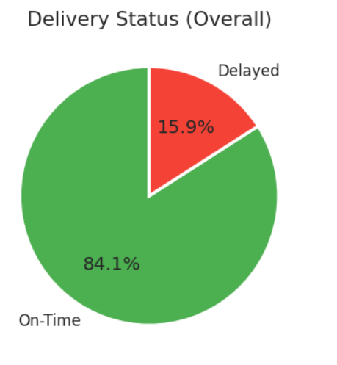
Exploratory Data Analysis
Key EDA Findings
Consumer Goods leads all categories at 17.5% delay rate
Imports delay 7% more often than Exports — customs asymmetry
Higher customs clearance time correlates with higher delay risk
Freight cost = consistently 5% of shipment value across all routes
9 / 15

Slide 10
Delay Probability Analysis & Predictive Modeling
Delay Probability Highlights
Predictive Model Results
Model Comparison
Segment | Delay Probability
Consumer Goods | 17.5%
Imports | 16.5%
Mumbai → Singapore | 25.0%
Singapore Destination | 25.0%
High Customs Clearance (>4 days) | 16.4%
Model | Main Observation
Logistic Regression | Achieved high overall accuracy (85%) but failed to correctly identify delayed shipments.
Decision Tree | Detected most delayed shipments effectively (78% recall), making it more suitable for proactive delay prediction.
Key Findings
Predictive analytics can help logistics teams proactively identify high-risk shipments and improve operational planning.
Decision Tree performed better in identifying shipment delays.
Customs clearance time was the most influential predictive feature.
Trade route and geographical factors also impacted delay probability

Slide 11
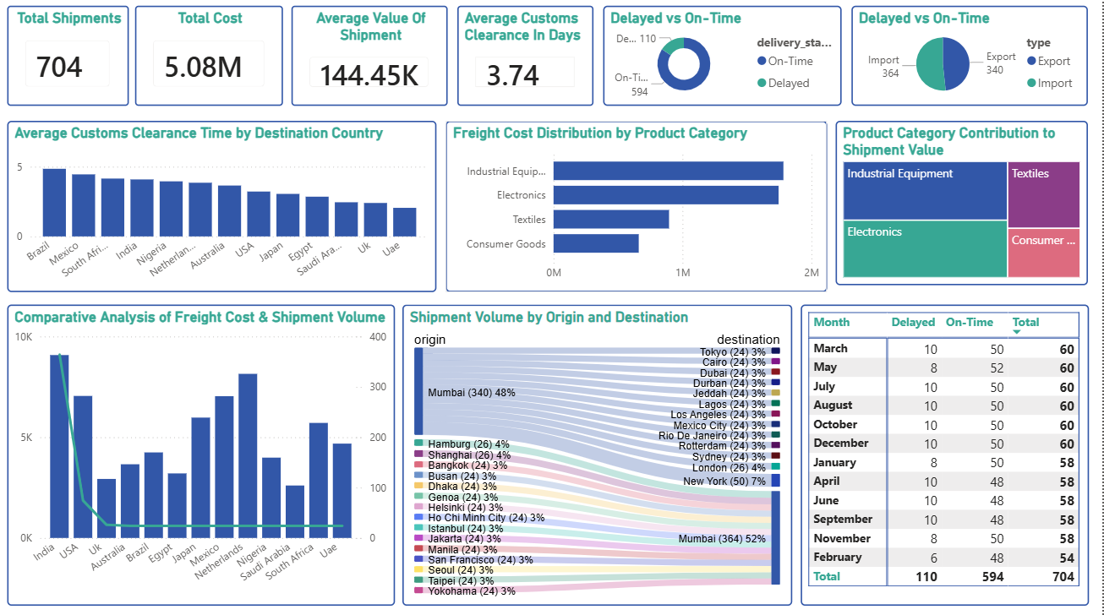
Data Visualization & Insights

Slide 12
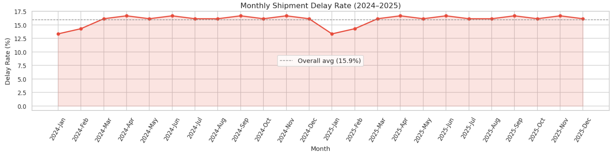
Data Visualization & Insights
25.0%
Mumbai → Singapore
Highest-risk single route
23.1%
UK-bound exports
Consistently above average
5%
Freight-to-value ratio
Uniform — pricing not a driver
4.9 days
Avg clearance for delayed
vs 3.6 days for on-time
10 / 15

Slide 13




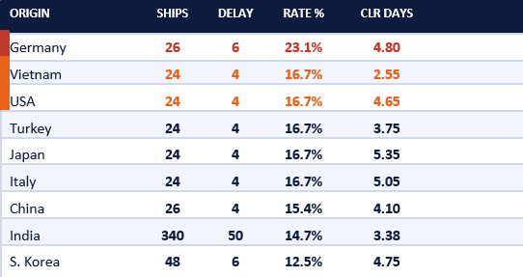
SQL-Driven Operational Intelligence for Supply Chain Optimization
INTRODUCTION
We load the cleaned logistics dataset into an in-memory SQLite database (728 rows) and run 6 business-relevant queries to simulate how this data would be interrogated in a real production environment — uncovering route inefficiencies, freight costs, delay patterns, and high-value shipment risks.
Logistics Data Architecture
Q1 · Most Delayed Routes
Q2 · Freight Cost by Product Category
shipments table · 728 rows
Average freight cost by product category
Industrial Equipment shipments generate disproportionately high freight costs, creating margin pressure and optimization opportunities in carrier contracts and shipment planning.
Operational
ROUTE
SHIPS
DELAY
RATE %
CATEGORY
AVG FREIGHT
AVG VALUE
RATIO
SHIPS
shipment_id
Mumbai → Singapore
24
6
25.0%
Industrial Equip.
$10,487
$210,311
0.043
type
170
origin / destination
Mumbai → London
26
6
23.1%
Electronics
$8,997
$179,936
0.050
O_Country / D_Country
194
product_category
Hamburg → Mumbai
26
6
23.1%
Textiles
$5,269
$105,379
0.050
170
delivery_status
Yokohama → Mumbai
24
4
16.7%
Consumer Goods
$3,406
$68,121
0.050
194
Financial
Taipei → Mumbai
24
4
16.7%
Industrial Equipment costs 3× more to ship than Consumer Goods → renegotiate freight contracts & optimize shipping methods.
value (INTEGER)
Seoul → Mumbai
24
4
16.7%
freight_cost (REAL)
SF → Mumbai
24
4
16.7%
Q3 · Delay Rate by Origin Country
freight_per_value (REAL)
customs_clearance_time_days
Mumbai → Sydney
24
4
16.7%
Delay rates increase materially in regions with extended customs clearance durations, indicating customs processing as a structural operational constraint.
Mumbai → Rio
24
4
16.7%
Mumbai → Mexico
24
4
16.7%
Engineered
year · month · quarter
INSIGHT
route · lane
Mumbai is central to the worst-performing routes. Singapore (25%) and London/Hamburg (23.1%) dominate delay counts. Root causes: customs congestion, carrier inefficiency, port bottlenecks. Action: prioritize alternate routing & SLA monitoring.
is_delayed (0/1)
high_value_shipment (0/1)
clearance_bucket
SQL analysis identified recurring delay bottlenecks, high-cost shipment categories, and customs-driven inefficiencies across critical international logistics routes.
Countries with longer customs clearance times also showed higher delay rates → customs is the main bottleneck.

Slide 14



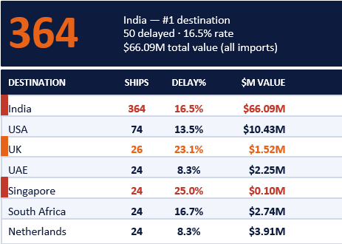
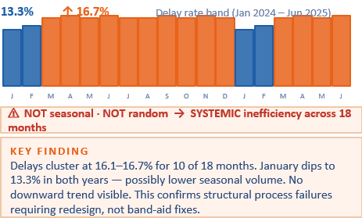
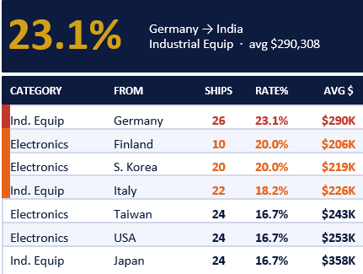

SQL-Driven Supply Chain Risk Intelligence
Q4 · Destination Country Volume
Q5 · Monthly Delay Trend
Q6 · High-Value Shipment Risks
India handles 364/728 = 50% of all shipments as pure import hub. High concentration creates operational pressure, congestion risk & delay exposure. Needs warehousing & capacity planning.
ACTIONS NEEDED
1. Process redesign at origin & carrier level
2. Logistics automation & predictive alerts
3. Escalation workflows for repeat-delay lanes
Japan Ind. Equip highest avg value ($357,500) — yet 16.7% delay rate. Maximum revenue at risk.
FINAL STRATEGIC INSIGHTS · Phase 7 SQL Summary
01
Mumbai = Risk Hub
02
Industrial = Costly
03
Customs = Bottleneck
04
India = Concentration Risk
05
Systemic Delays
Mumbai appears in 4 of top 5 worst routes. Dedicated monitoring & carrier renegotiation required urgently.
Industrial Equipment costs $10,487 avg freight vs $3,406 Consumer Goods. Renegotiate contracts, explore sea-air hybrid routing.
Germany (23.1%, 4.80 days) and Japan/Italy (5+ days clearance) confirm customs as primary delay driver. Pre-clearance & documentation automation needed.
50% of all shipments flow to India. Single-hub dependency creates congestion & delay amplification. Needs warehousing + capacity buffers.
18 months of 13–17% delay rates with no improvement trend. Structural redesign + automation required — not tactical fixes.

Slide 15
GenAI Integration
Anthropic Claude API — converting analytical findings into operational recommendations
Cleaned
Data Layer
Analytics
Summary
Structured
Prompt
Claude API
claude-sonnet-4
Action
Playbook
728 rows
shipment_cleaned.csv
Delay rates, route
risk, customs impact
Context-enriched
business query
Anthropic
LLM Engine
Route-specific
recommendations
What GenAI Receives
What GenAI Produces
• Overall delay rate: 15.9% • Highest-risk category: Consumer Goods (17.5%) • Top route risk: Mumbai → Singapore (25.0%) • Customs clearance impact: +1.3 days for delayed shipments • Origin risk: Germany highest at 23.1%
Not raw data — only cleaned summary statistics
Named route-level delay reduction actions with carrier alternatives
Customs pre-clearance triggers for high-risk categories
Documentation automation recommendations to cut clearance time
SLA buffer adjustments by origin country and product type
Priority matrix for logistics team intervention by delay probability
11 / 15

Slide 16
Key Insights & Recommendations
HIGH
Mumbai → Singapore: 25% delay rate
Expected Impact
Action: Evaluate alternate logistics carriers for this lane. Initiate pre-clearance paperwork 72 hrs before dispatch.
Est. 8–12% delay reduction on this route
HIGH
Consumer Goods highest delay category at 17.5%
Expected Impact
Action: Assign dedicated customs compliance agent for Consumer Goods shipments. Standardise documentation checklist.
Reduces processing exceptions and documentation re-submissions
MEDIUM
Customs clearance >4 days → 41% higher delay risk
Expected Impact
Action: Implement automated document review flag for shipments predicted to exceed 4-day clearance threshold.
Proactive intervention window of 2–3 days per flagged shipment
MEDIUM
Germany origin: 23.1% delay rate — highest among all origins
Expected Impact
Action: Build additional 2-day buffer into SLAs for Germany-origin shipments. Review vendor lead time compliance.
Prevents SLA breaches and client escalations on this corridor
LOW
Freight cost uniformly 5% of value — no dynamic pricing
Expected Impact
Action: Benchmark against market rates for high-volume lanes. Negotiate volume-tiered freight rates with carriers.
Potential 2–4% freight cost savings on high-volume India–USA lane
12 / 15

Slide 17
Conclusion & Future Scope
704
15.9%
Shipments analyzed
Baseline delay rate
What We Delivered
Future Scope
Real-time delay prediction API integrated into logistics TMS
Expanded dataset: actual lead times, carrier identifiers, cost breakdowns
LSTM time-series model for seasonal delay forecasting
Live Sankey dashboard connected to live shipment data feed
Automated SLA alert system triggered by delay risk score threshold
Full end-to-end analytics pipeline on 704 real shipments
Root-cause identification of 3-column data corruption (24 rows)
Conditional delay probability tables across all segments
Predictive ML model with feature importance analysis
6 business SQL queries on a production-ready schema
GenAI-powered route-level operational playbook

